Slide 1
New Graph Algorithms via Polyhedral Techniques
Jakub Tarnawski
Microsoft Research
14.09.2020
8th Polish Combinatorial Conference

Slide 2
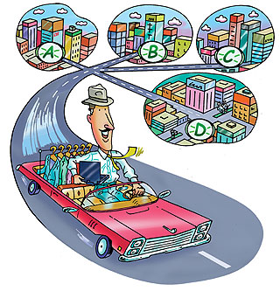
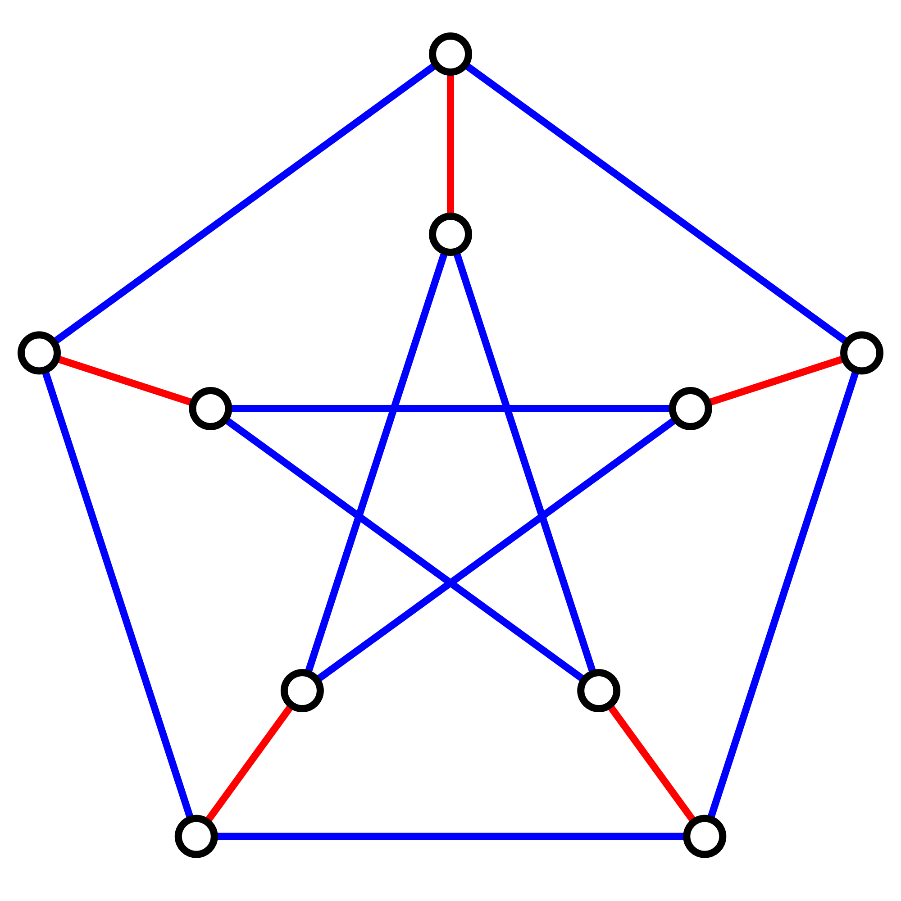
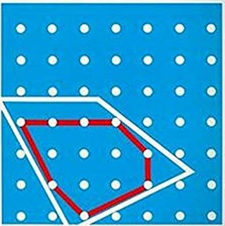
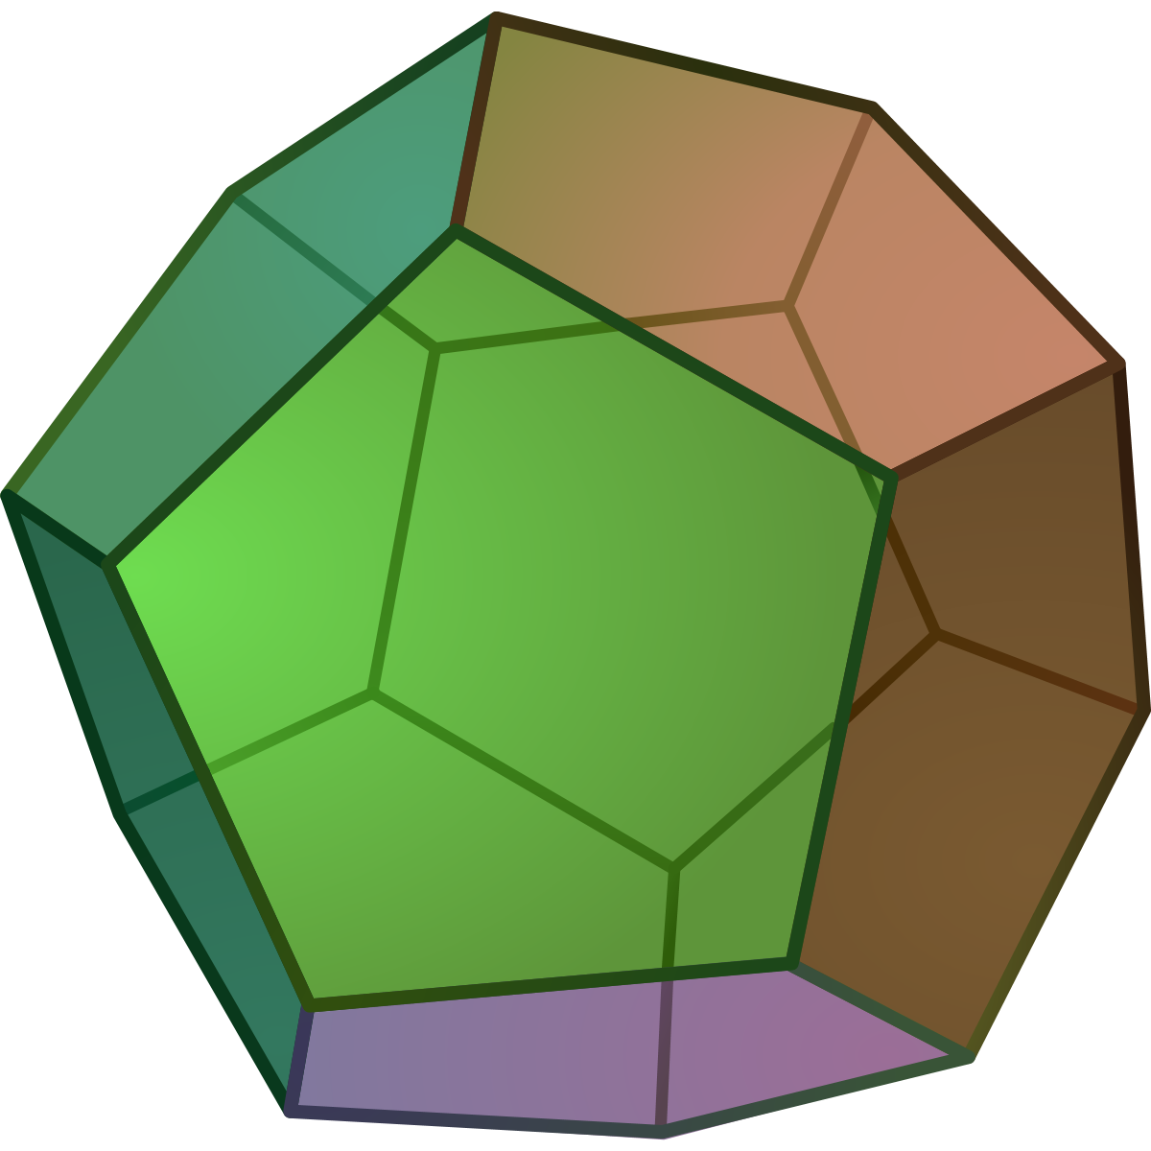

The two results for today
1. Asymmetric Traveling Salesman Problem
2. Perfect Matching
Constant-factor approximation algorithm
Parallel deterministic algorithm (quasi-NC)

Slide 3
1. Asymmetric Traveling Salesman Problem
Constant-factor approximation algorithm

Slide 4
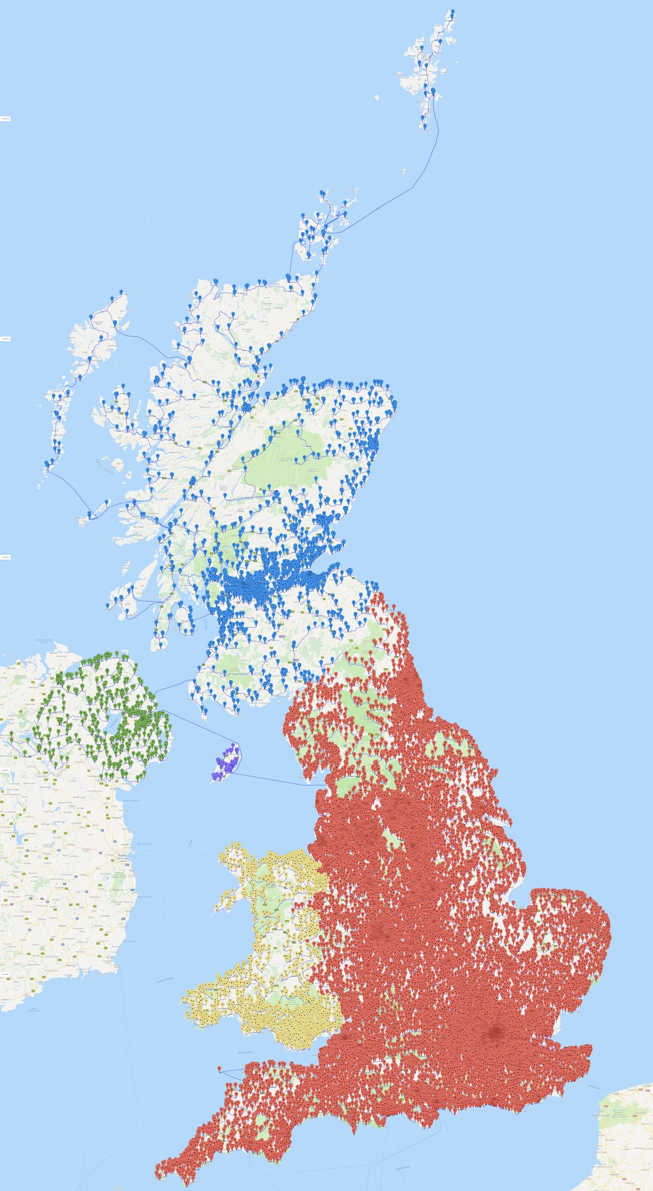
How long does it take to visit all the 49,687 pubs in the UK?
Answer:
63,739,687 meters
[Cook, Espinoza, Goycoolea, Helsgaun 2018]

Slide 5
TSP: Traveling Salesman Problem
Given: a graph with weights on edges
Find: the shortest tour that visits all vertices at least once
3
1
6
5
2
1
8
4
4
8
5
1
3
1
3
4
5
1
6
3
6
2
8
1
3

Slide 6
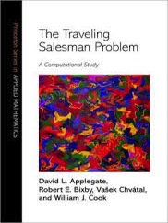
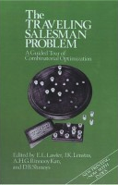
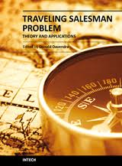
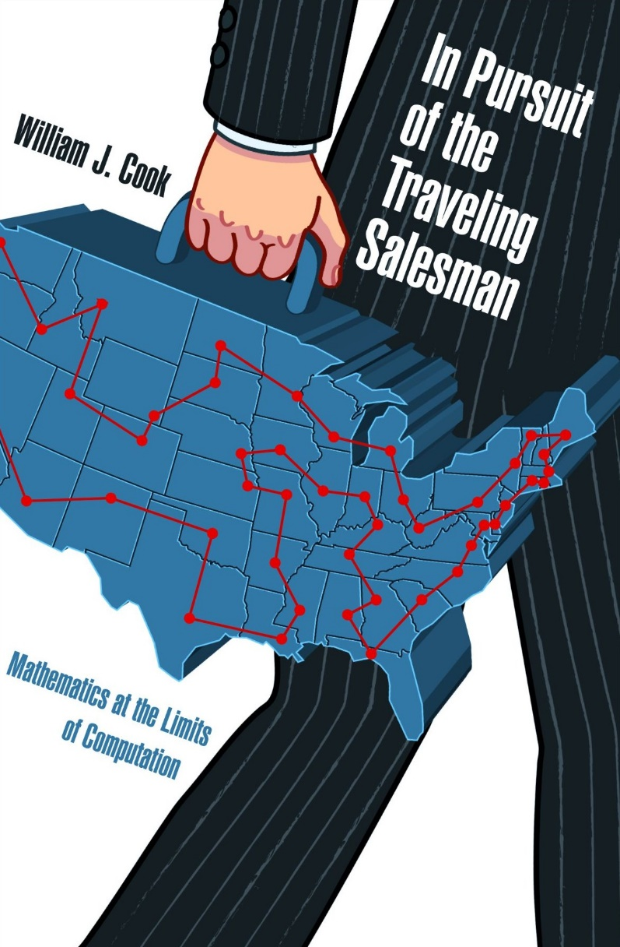
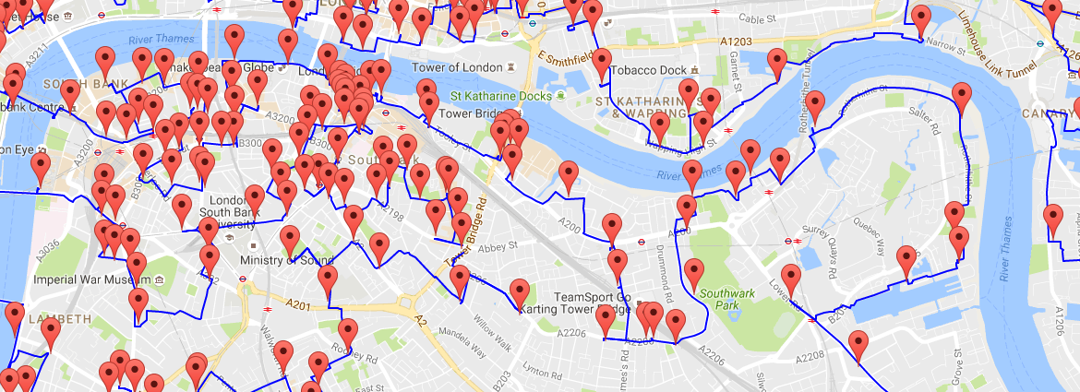
TSP: Traveling Salesman Problem
Variants studied in mathematics by Hamilton and Kirkman already in the 1800’s
Benchmark problem for algorithmic techniques of today:
  one of the most studied NP-hard
  combinatorial optimization problems
  state of knowledge
  is far from satisfactory

Slide 7
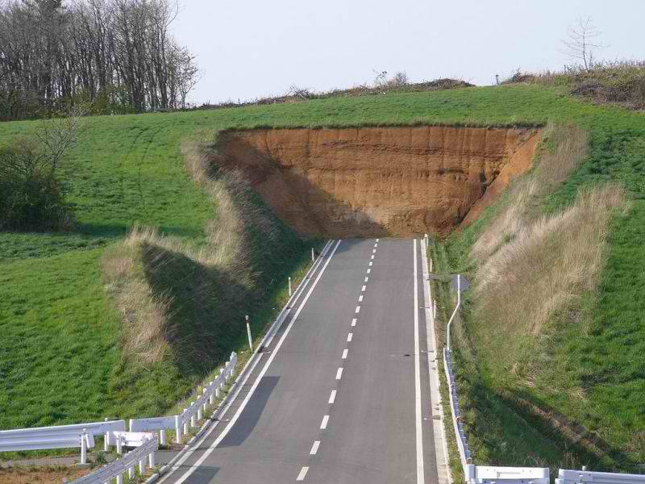
finds optimal solution
polynomial-time
reliable
(high-quality solutions)
efficient
NP-hardness
Goal: design
optimal algorithms
solid understanding (provable guarantees)
for every instance

Slide 8
$$cost\left(found solution\right)≤ρ∙cost(opt solution)$$
finds optimal solution
polynomial-time
reliable
(high-quality solutions)
efficient
Approximation algorithms
$ρ$-approximation algorithm
apx ratio
solid understanding (provable guarantees)
for every instance

Slide 9
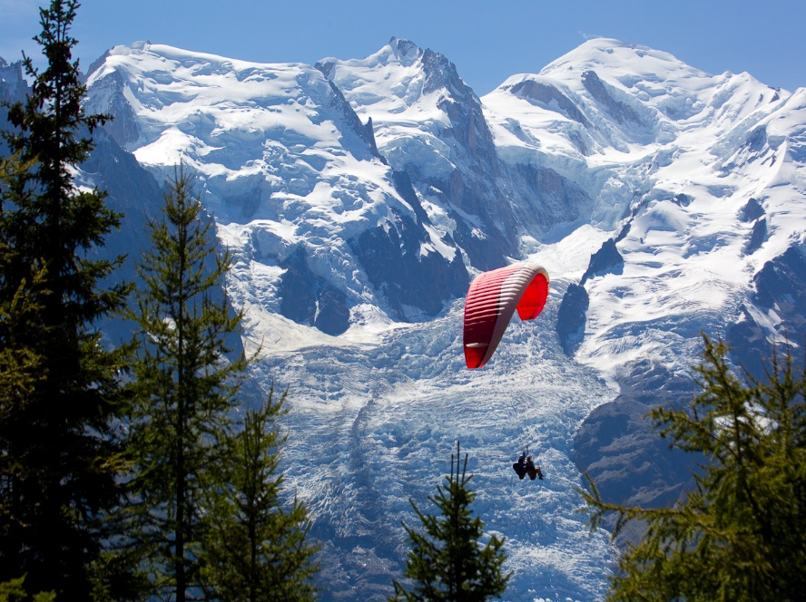
Two basic versions
Symmetric: distance(u,v) = distance(v,u)
3
u
v
2-approximation is trivial
3
Asymmetric: more general, no such assumption is made
v
100
2
u

Slide 10
What is the approximability of Asymmetric TSP?

Slide 11

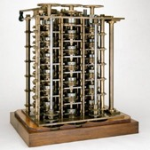
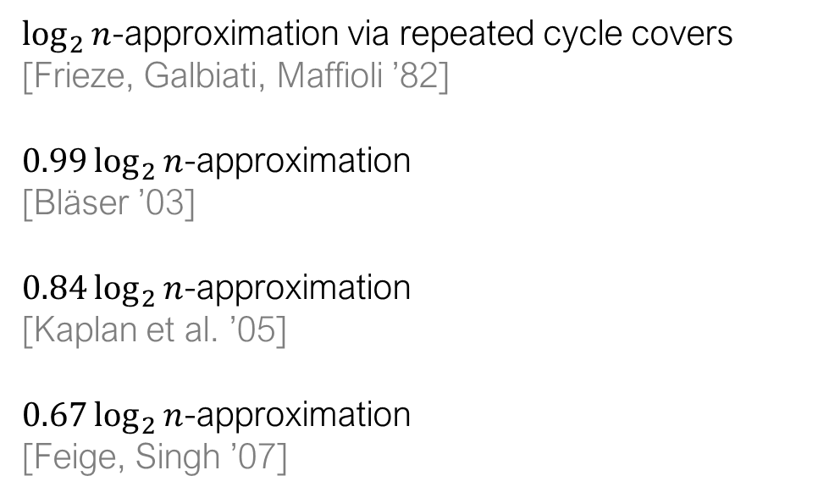
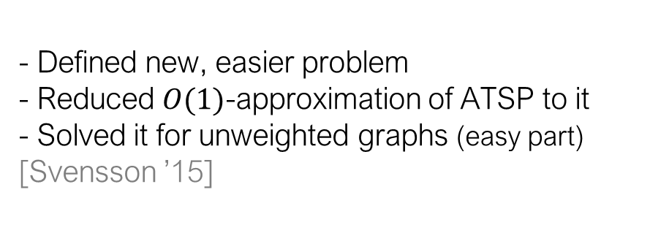
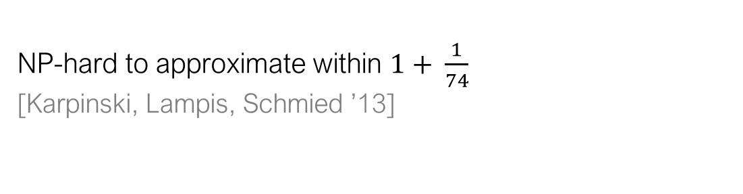
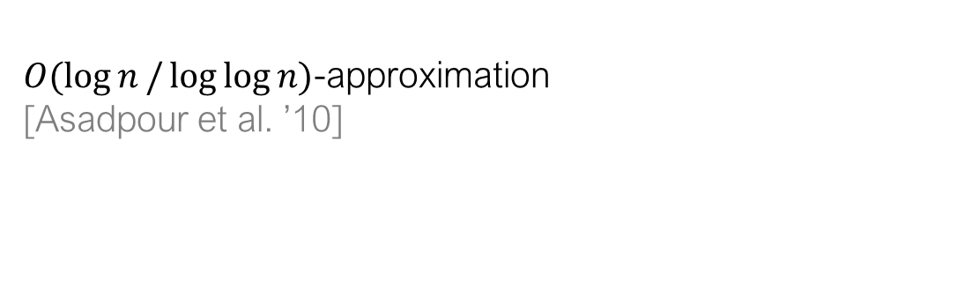
Prior work
Local-Connectivity ATSP
$\log_{2}{n}$-approximation via repeated cycle covers
[Frieze, Galbiati, Maffioli ’82]
$0.99\log_{2}{n}$-approximation
[Bläser ’03]
$0.84\log_{2}{n}$-approximation
[Kaplan et al. ’05]
$0.67\log_{2}{n}$-approximation
[Feige, Singh ’07]
- Defined new, easier problem
- Reduced $O(1)$-approximation of ATSP to it
- Solved it for unweighted graphs (easy part)
[Svensson ’15]
[Svensson, T., Vegh’16]:
$O(\log{n}/\log{\log{n)}}$-approximation
[Asadpour et al. ’10]
i’11]
unweighted
ATSP
2-edge-weights
ATSP
[Svensson’15]
unweighted
Local-Connectivity ATSP
2-edge-weights
Local-Connectivity ATSP
Hardness
easy
doable
NP-hard to approximate within $1+ \frac{1}{74}$
[Karpinski, Lampis, Schmied ’13]

Slide 12
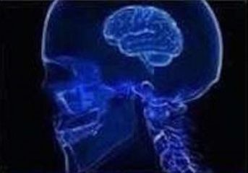
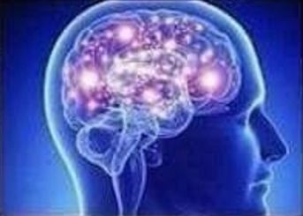
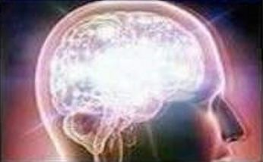
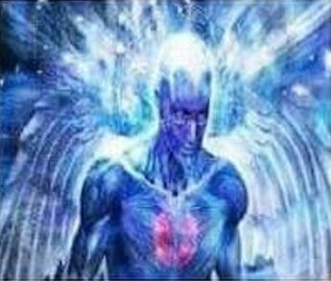

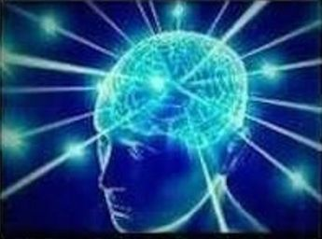
Theorem [Svensson, T., Végh STOC 2018 Best Paper Award]:
There is a constant-factor approximation algorithm for ATSP
2-edge-weights
ATSP
general
ATSP
structured
ATSP
[Svensson’15]
[Svensson’15]
2-edge-weights
Local-Connectivity ATSP
general
Local-Connectivity ATSP
more structured
ATSP
Solve
[Svensson, T., Vegh’16]
really structured
Local-Connectivity ATSP
really structured
ATSP
[Svensson’15]
Solve

Slide 13
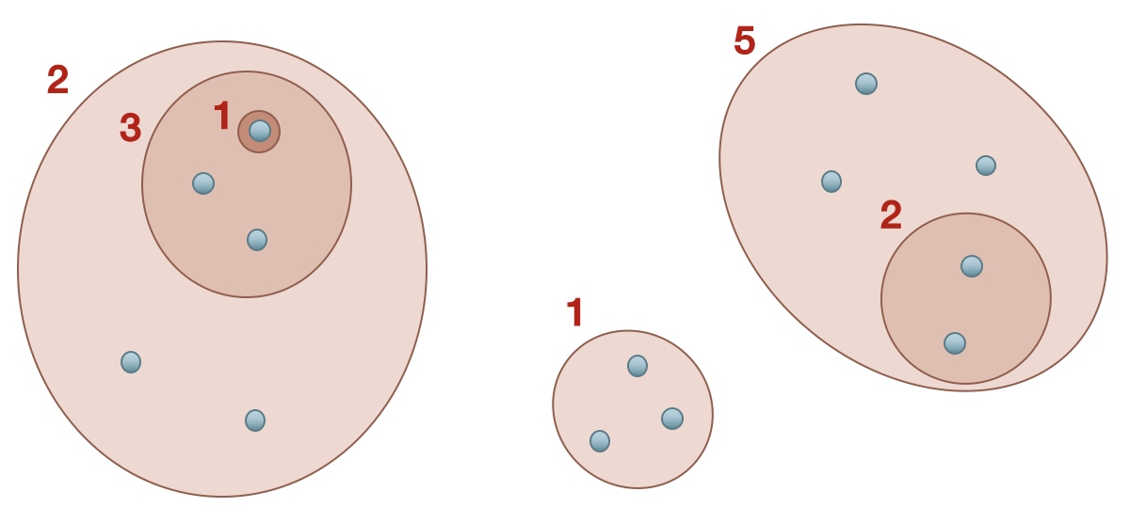
Two key steps:
Get weight functions that are not arbitrary but come from a laminar structure
Use laminar structure to make progress
by recursing
weight=1+3+2+5
weight=2+5+1

Slide 14

Two key steps:
Get weight functions that are not arbitrary but come from a laminar structure
Use laminar structure to make progress
by recursing
weight=1+3+2+5
weight=2+5+1

Slide 15

General instance:
  no structure on edge weights
Structured instance:
  edge weights defined by laminar family of vertex subsets
Edge weight = value of sets it crosses
3
2
1
2
1
LP duality
Uncrossing
5
1+4=5
4
2
1
5000
3
2
7
3
1
No two sets intersect
non-trivially

Slide 16

Recursive strategy
Contract set in laminar family
Solve smaller instance recursively
Lift to a subtour in original instance
Complete subtour to tour
2
6
1
2
5
1
4
2
3
2
7
3
1
OPT-value = $OPT$
* edges not depicted

Slide 17

Recursive strategy
Contract set in laminar family
Solve smaller instance recursively
Lift to a subtour in original instance
Complete subtour to tour
2
6
2
6
1
1
2
2
5
1
4
2
17
3
2
7
3
7
3
1
1
OPT-value = $OPT$
OPT-value = $OPT−drop$
* edges not depicted

Slide 18
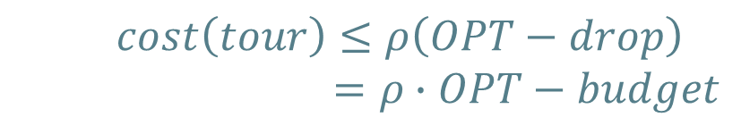
Recursive strategy
Contract set in laminar family
Solve smaller instance recursively
Lift to a subtour in original instance
Complete subtour to tour
2
6
2
6
1
1
2
2
5
1
4
2
17
3
2
7
3
7
3
1
1
OPT-value = $OPT$
OPT-value = $OPT−drop$
$$cost\left(tour\right)≤ρ\left(OPT−drop\right)$$
$=ρ∙OPT−budget$
* edges not depicted

Slide 19

Recursive strategy
Contract set in laminar family
Solve smaller instance recursively
Lift to a subtour in original instance
Complete subtour to tour
2
6
2
6
1
1
2
2
5
1
4
2
17
3
2
7
3
7
3
1
1
OPT-value = $OPT$
OPT-value = $OPT−drop$
$$cost\left(subtour\right)≤ρ∙OPT−budget$$
$$cost\left(tour\right)≤ρ\left(OPT−drop\right)$$
$=ρ∙OPT−budget$

Slide 20

Recursive strategy
Contract set in laminar family
Solve smaller instance recursively
Lift to a subtour in original instance
Complete subtour to tour
This gives a good tour if $drop$ is large enough
But: instances where contracting does not
lead to a large drop contain lots of structure
(almost Hamiltonian)
On those instances we solve Local-Connectivity ATSP
2
6
2
6
1
1
2
2
5
1
4
2
17
3
2
7
3
7
3
1
1
OPT-value = $OPT$
OPT-value = $OPT−drop$
$$cost\left(subtour\right)≤ρ∙OPT−budget$$
$$cost\left(tour\right)≤ρ\left(OPT−drop\right)$$
$=ρ∙OPT−budget$
$$cost\left(subtour+completion\right)≤ρ∙OPT$$

Slide 21
Summary
Theorem [Svensson, T., Végh STOC 2018 Best Paper Award]:
There is a constant-factor approximation algorithm for ATSP
LP techniques yield laminar structure
Use it to make progress
3
2
1
2
5
1
4
2
3
2
7
3
1

Slide 22
1. Asymmetric Traveling Salesman Problem
Constant-factor approximation

Slide 23
2. Perfect Matching
Parallel deterministic algorithm (quasi-NC)

Slide 24
Perfect matching problem
Given: an undirected graph
Find out if we can pair up all vertices using edges
perfect matching
Benchmark problem for class P

Slide 25
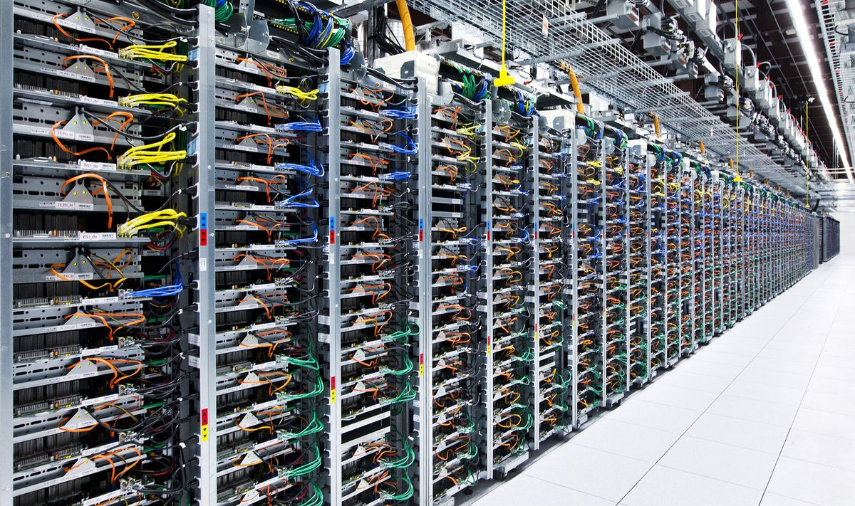


NC: class of problems that parallelize completely
poly(n) processors
polylog(n) time
It’s in Randomized NC
[Lovász 1979]
Main open question: is matching in NC?

Slide 26
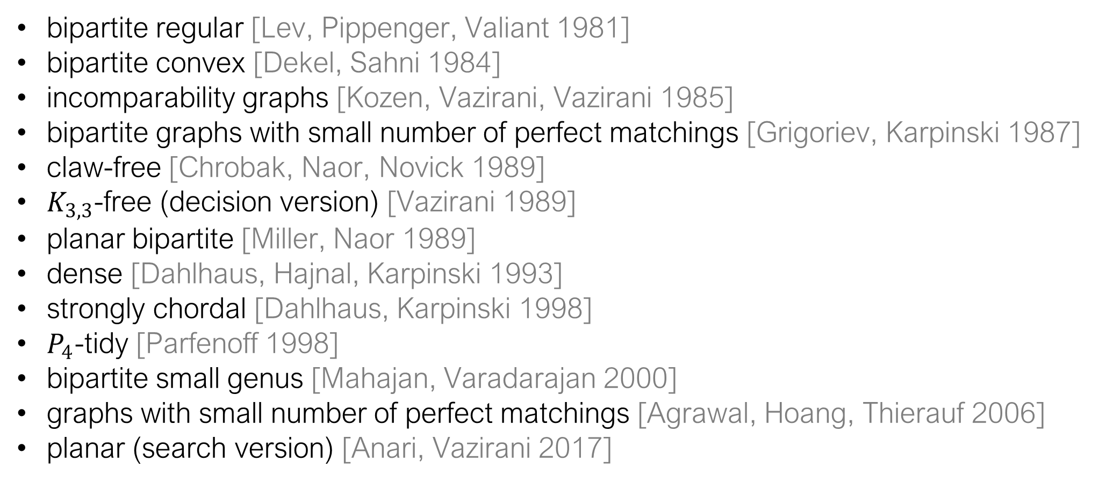
Is matching in NC?
Yes, for restricted graph classes:
bipartite regular [Lev, Pippenger, Valiant 1981]
bipartite convex [Dekel, Sahni 1984]
incomparability graphs [Kozen, Vazirani, Vazirani 1985]
bipartite graphs with small number of perfect matchings [Grigoriev, Karpinski 1987]
claw-free [Chrobak, Naor, Novick 1989]
$K_{3,3}$-free (decision version) [Vazirani 1989]
planar bipartite [Miller, Naor 1989]
dense [Dahlhaus, Hajnal, Karpinski 1993]
strongly chordal [Dahlhaus, Karpinski 1998]
$P_{4}$-tidy [Parfenoff 1998]
bipartite small genus [Mahajan, Varadarajan 2000]
graphs with small number of perfect matchings [Agrawal, Hoang, Thierauf 2006]
planar (search version) [Anari, Vazirani 2017]
But not known for:
General
Bipartite

Slide 27
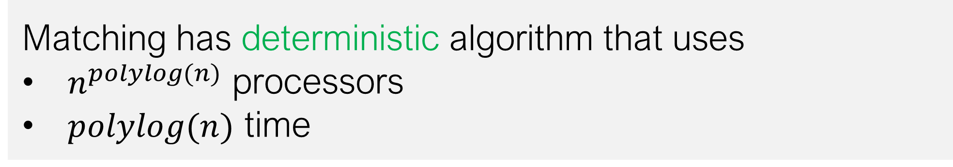
Theorem [Svensson, T., FOCS 2017 Best Paper Award]:
Matching is in quasi-NC
Matching has deterministic algorithm that uses
$n^{polylog(n)}$ processors
$polylog(n)$ time
Best known previously: $exp⁡(n)$ processors
Generalizes work by [Fenner, Gurjar, Thierauf 2015]
who showed that bipartite matching is in quasi-NC

Slide 28
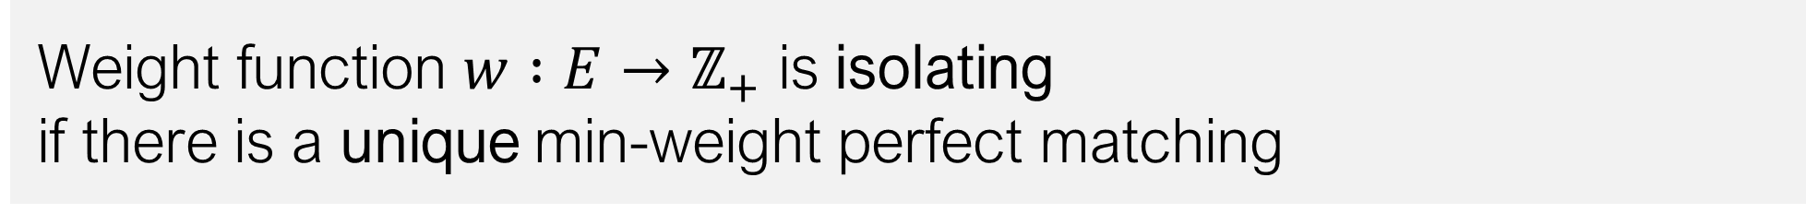
Algorithm of Mulmuley, Vazirani, Vazirani [1987]
Difficulty: too many possible matchings
unweighted
problem
weighted
problem
Solution: look for a min-weight perfect matching
Weight function $w :E→ℤ_{+}$ is isolating
if there is a unique min-weight perfect matching

Slide 29
Algorithm of Mulmuley, Vazirani, Vazirani [1987]
random sampling
something deterministic?
How to get an isolating weight function
deterministically in NC?
Isolation Lemma
?
isolating weight function
determinant
computation in NC
Weight function $w :E→ℤ_{+}$ is isolating
if there is a unique min-weight perfect matching
matching

Slide 30
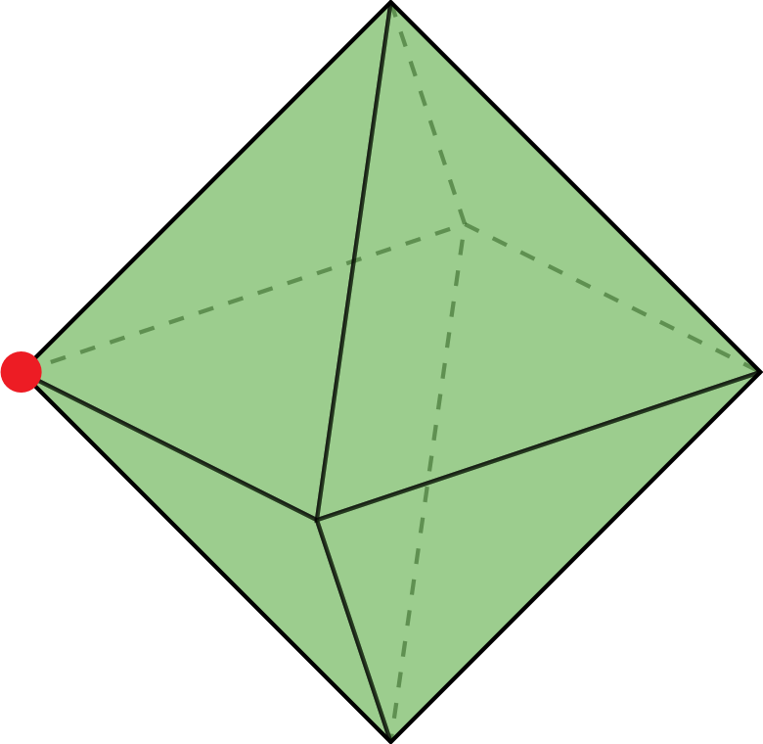
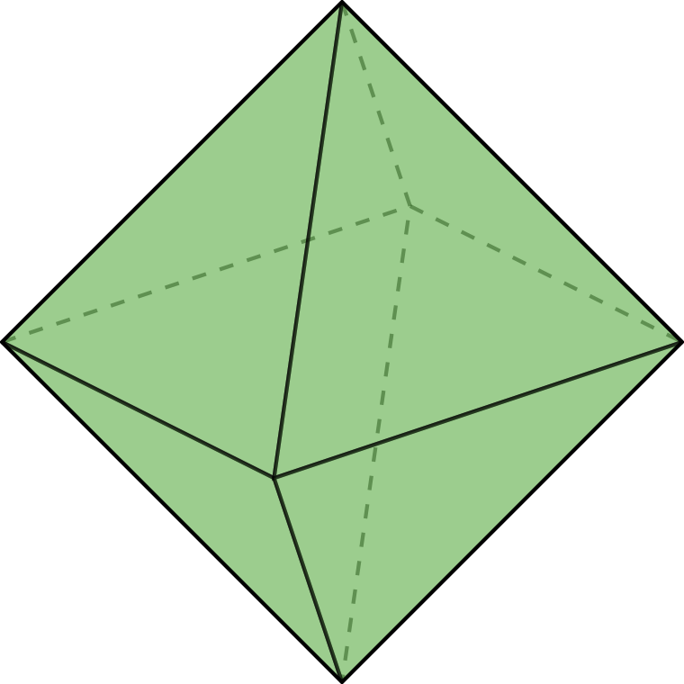
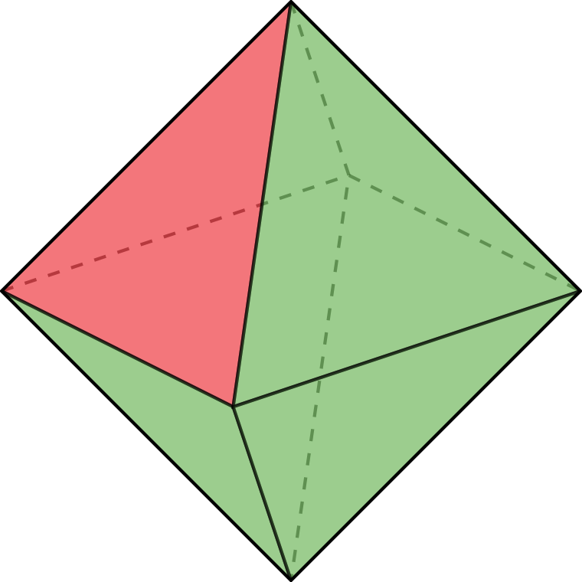
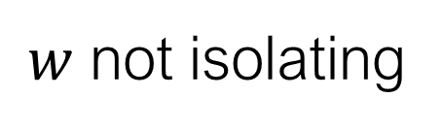

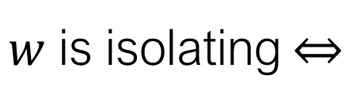
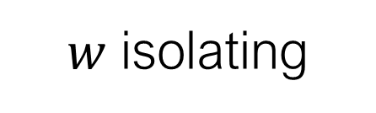


Polyhedral perspective
matching $M$ = indicator vector $χ_{M}∈{\{0,1\}}^{E}$
perfect matching polytope = convex hull of all perfect matchings
set of points that minimize $w$
=
convex hull of
min-weight matchings
=
face of perfect matching polytope
this face is a single vertex
$w$ is isolating $⇔$
$$w$$
$$⊆ℝ^{E}$$
$w$ not isolating
$w$ isolating

Slide 31
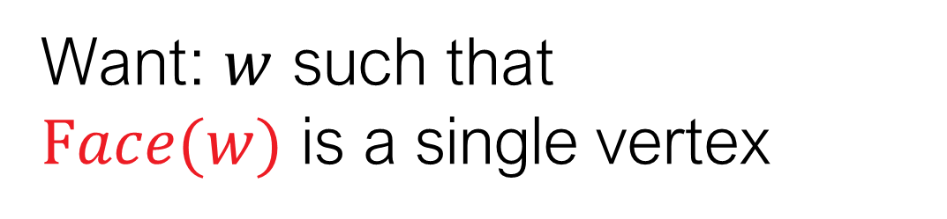

Want: $w$ such that
$Face(w)$ is a single vertex
$$w$$
LP theory
Uncrossing
Every face can be described using:
subset of edges
laminar family of vertex sets
~

Slide 32
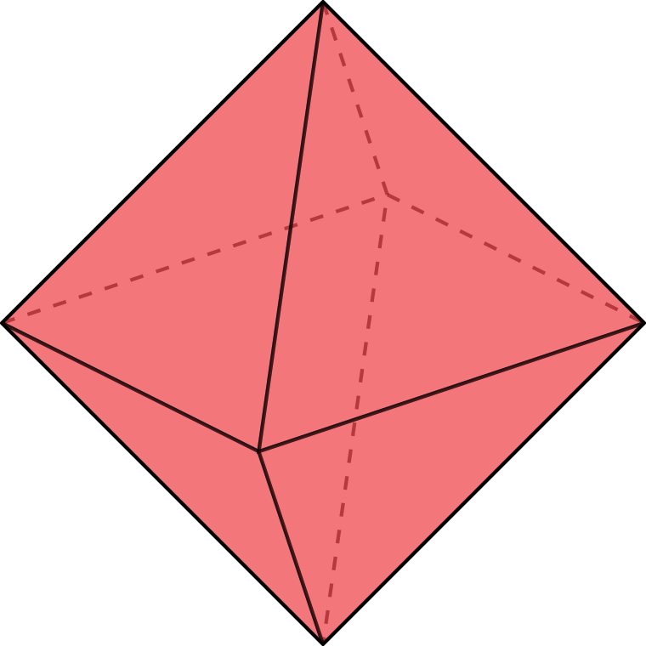
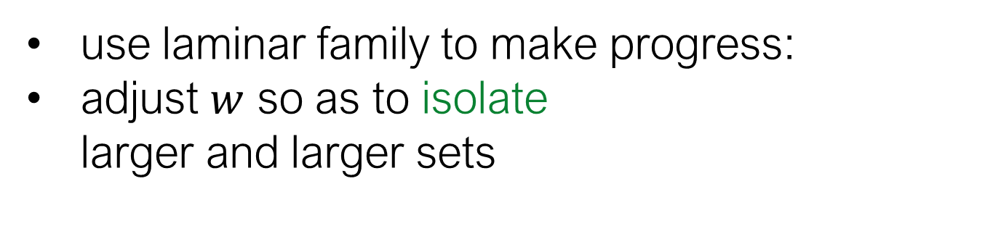
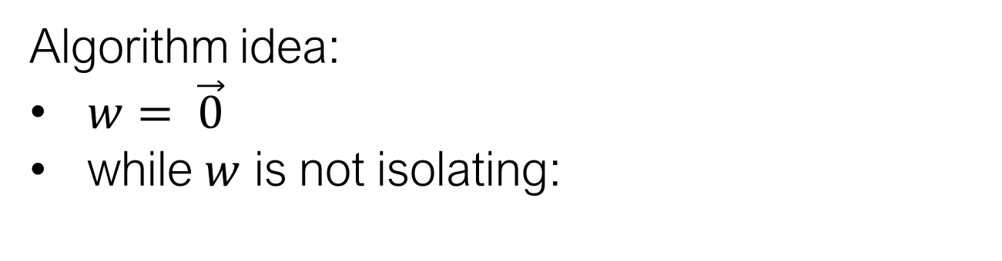

Algorithm idea:
$w= \vec{0}$
while $w$ is not isolating:
use laminar family to make progress:
adjust $w$ so as to isolate
larger and larger sets
$$w$$

Slide 33
Algorithm idea:
$w= \vec{0}$
while $w$ is not isolating:
use laminar family to make progress:
adjust $w$ so as to isolate
larger and larger sets
$$w$$

Slide 34
Algorithm idea:
$w= \vec{0}$
while $w$ is not isolating:
use laminar family to make progress:
adjust $w$ so as to isolate
larger and larger sets
$$w$$

Slide 35
Algorithm idea:
$w= \vec{0}$
while $w$ is not isolating:
use laminar family to make progress:
adjust $w$ so as to isolate
larger and larger sets
$$w$$

Slide 36
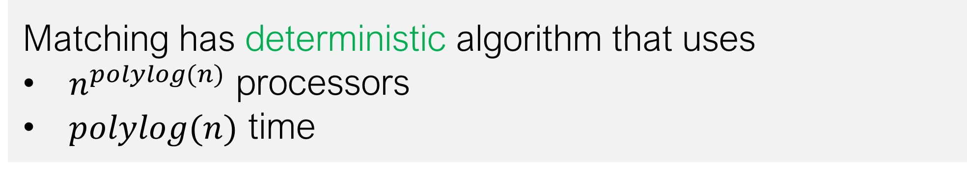
Summary
Theorem [Svensson, T., FOCS 2017 Best Paper Award]:
Matching is in quasi-NC
Matching has deterministic algorithm that uses
$n^{polylog(n)}$ processors
$polylog(n)$ time
LP techniques yield laminar structure
Use it to make progress

Slide 37

Future work

Slide 38
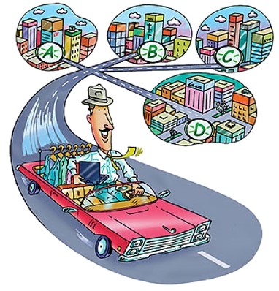
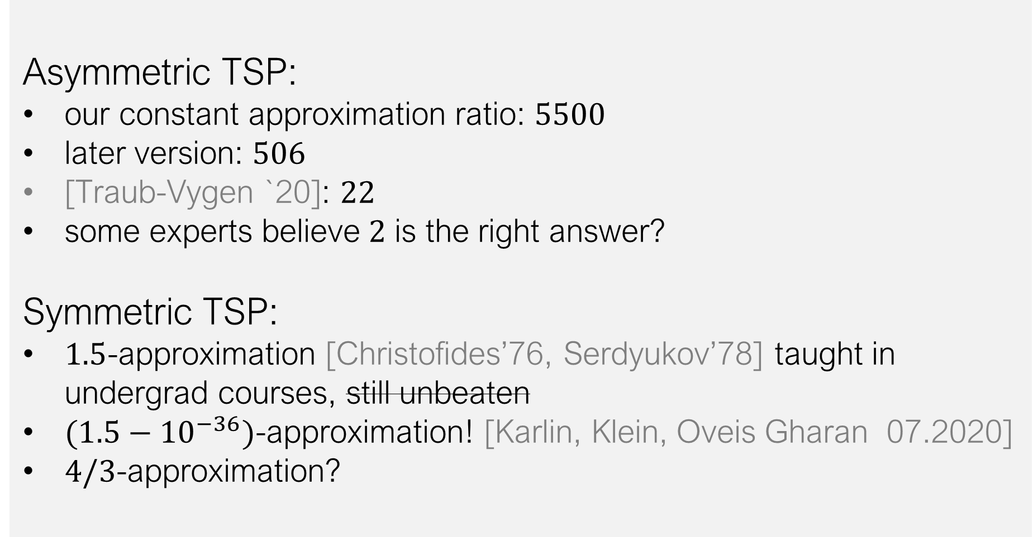
Asymmetric TSP:
our constant approximation ratio: $5500$
later version: $506$
[Traub-Vygen `20]: $22$
some experts believe $2$ is the right answer?
Symmetric TSP:
$1.5$-approximation [Christofides’76, Serdyukov’78] taught in undergrad courses, still unbeaten
$(1.5−{10}^{−36})$-approximation! [Karlin, Klein, Oveis Gharan 07.2020]
$4/3$-approximation?

Slide 39
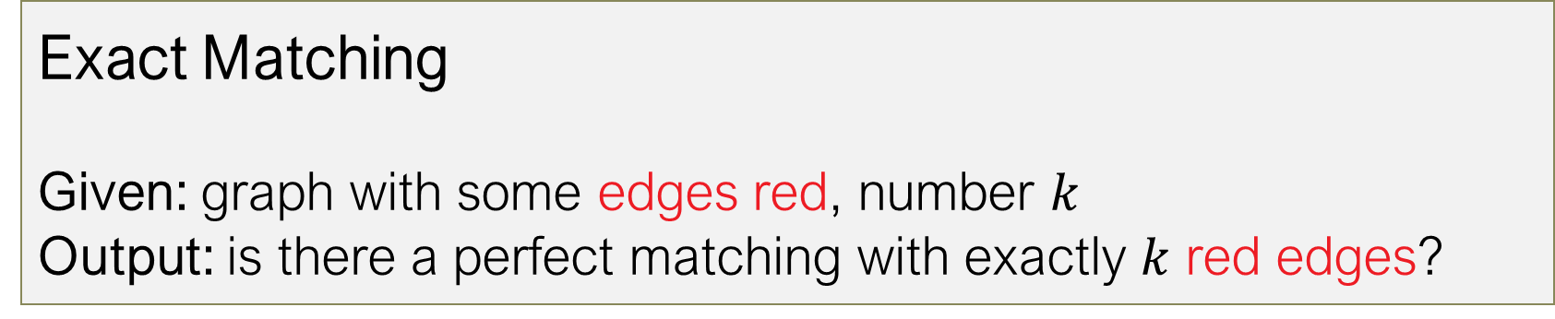


We really should solve the following:
Exact Matching
Given: graph with some edges red, number $k$
Output: is there a perfect matching with exactly $k$ red edges?
It has a randomized poly-time algorithm
It is even in Randomized NC
Not known to be in P!
$$k=2$$
$$YES$$

Slide 40

Thank you!

